Slide 1
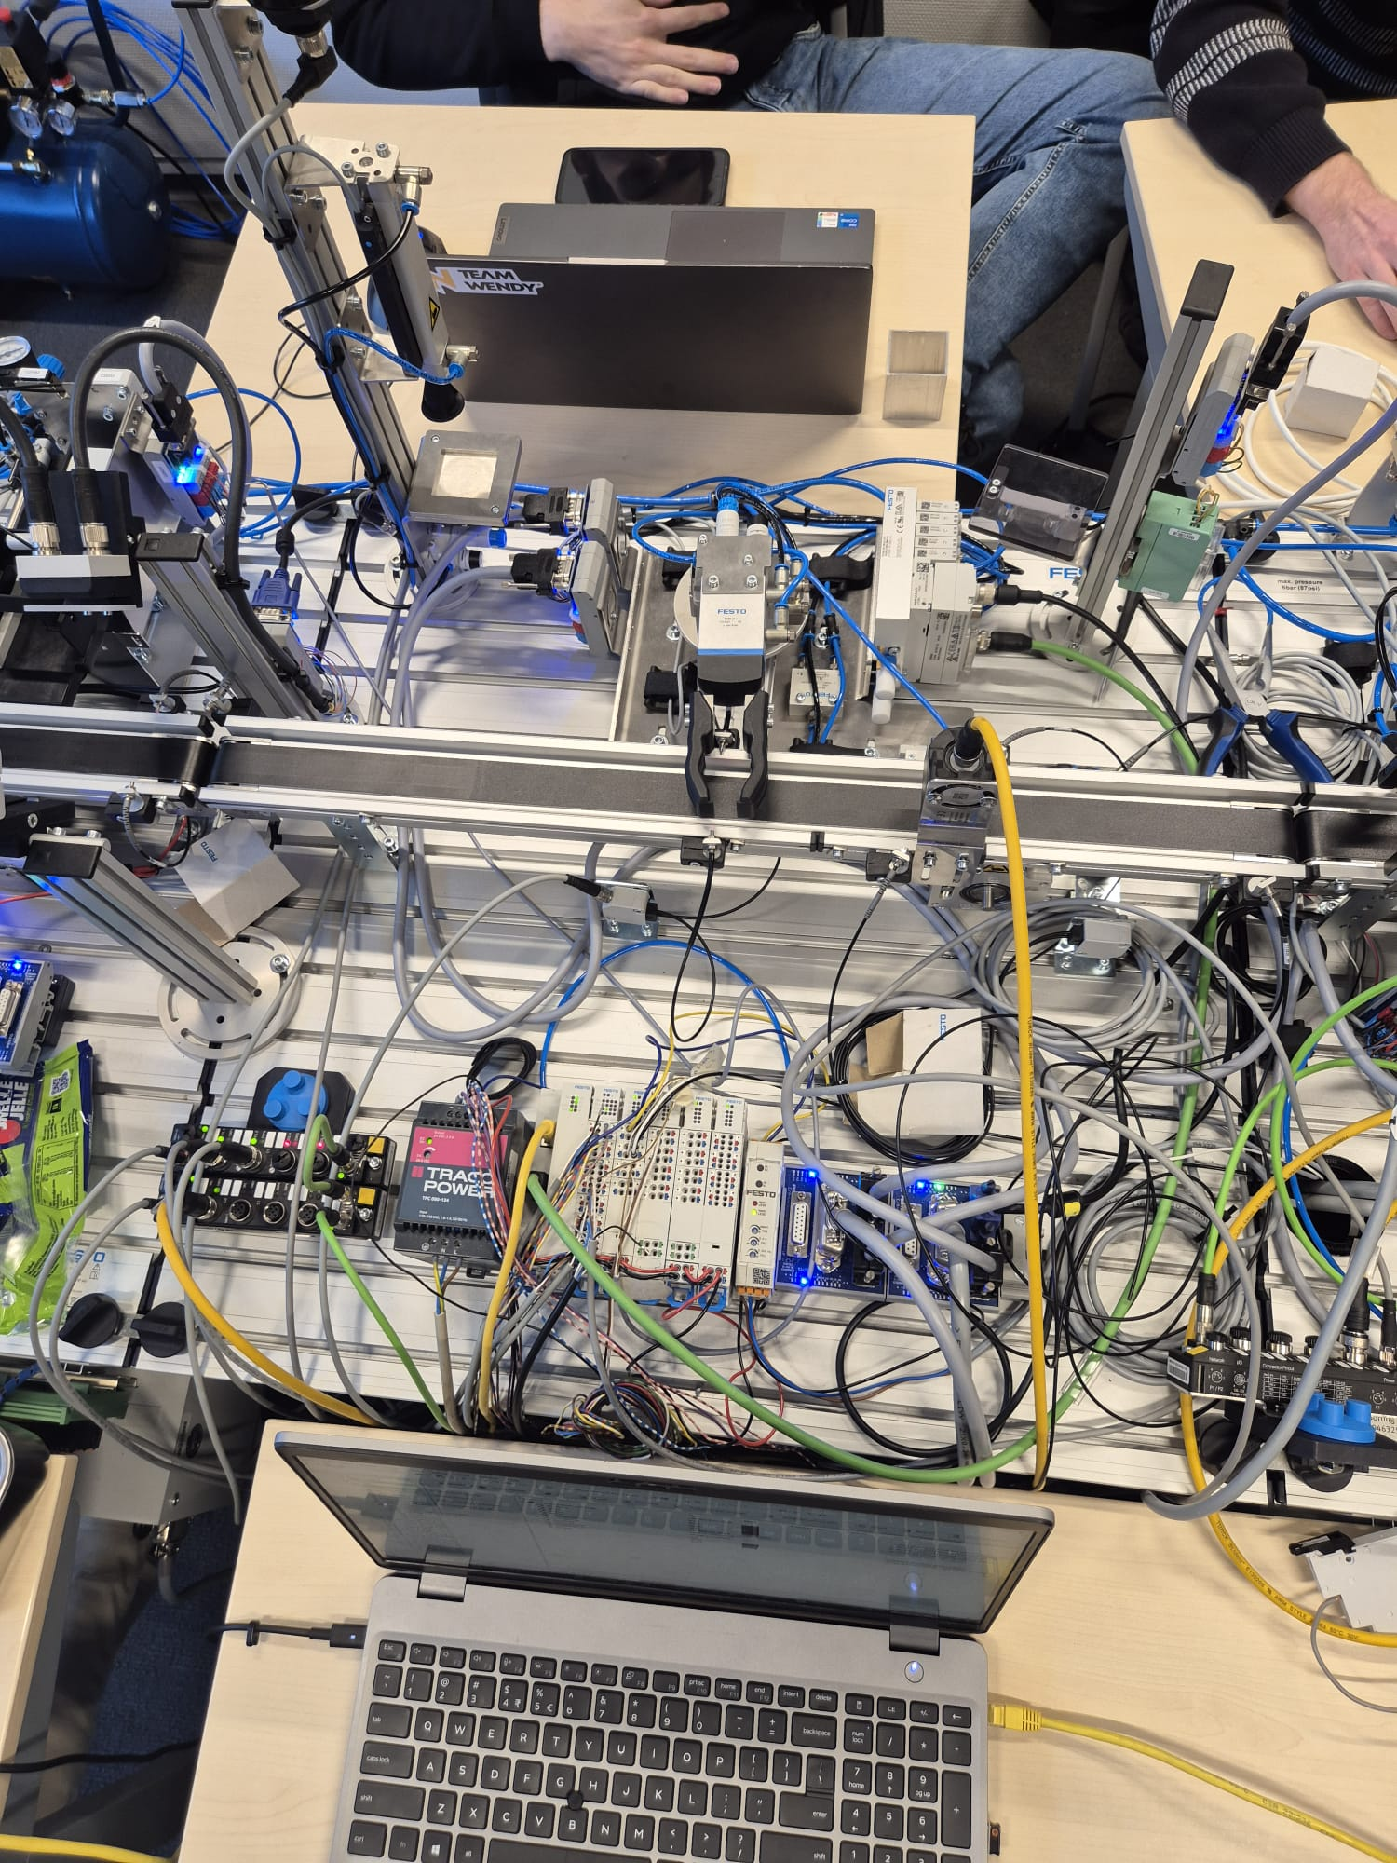
Connectivity
Measuring station
By Quinten Weerkamp, Rick Nijmeijer en Gijs Winkelhorst

Slide 2
Table of content
Problem statement
Setup
components
Programming
Scada
HMI
Conclusions and recommendations

Slide 3
Problem statement
Transport block
Measure Height
Measure Weight
Write data to RFID-tag (if present)
Write data to ignition
Add data into table

Slide 4

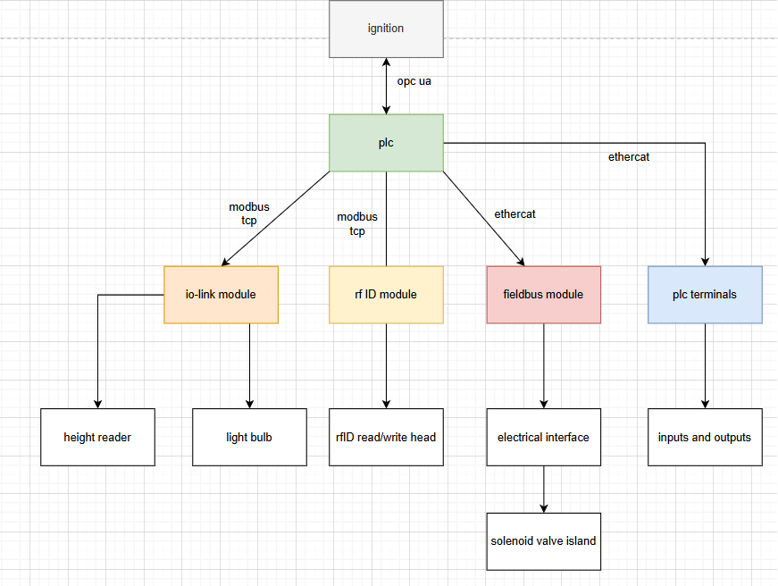
Setup
Festo cpx-e-cec-c1 PLC

Slide 5
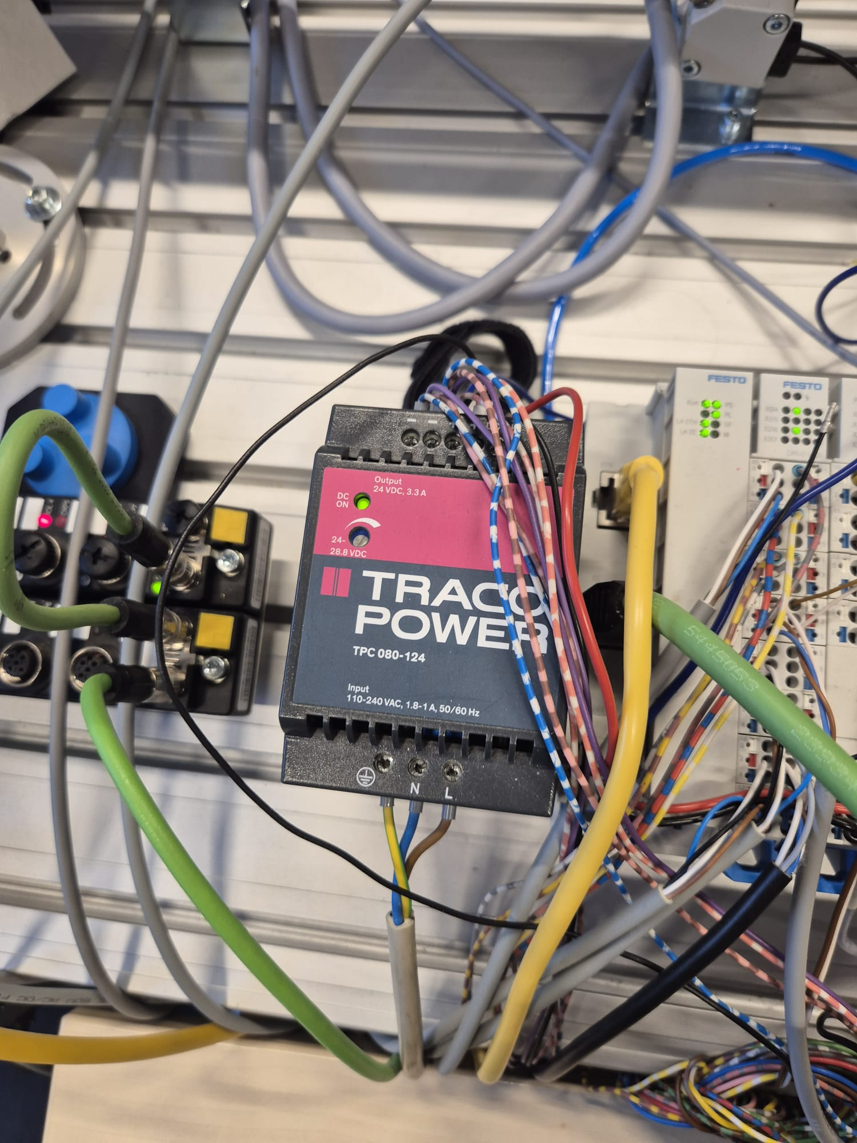
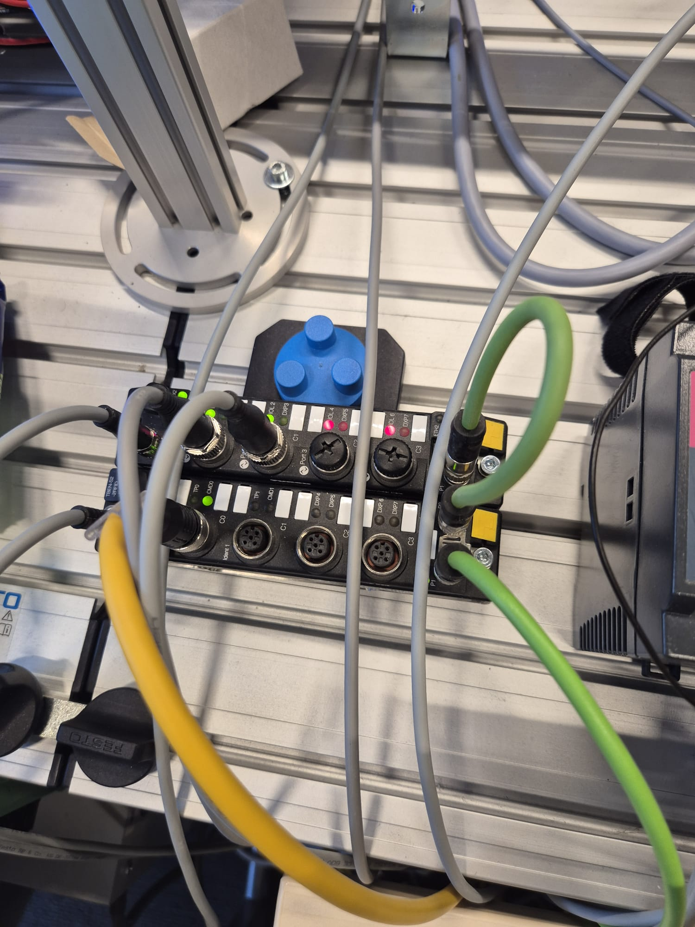
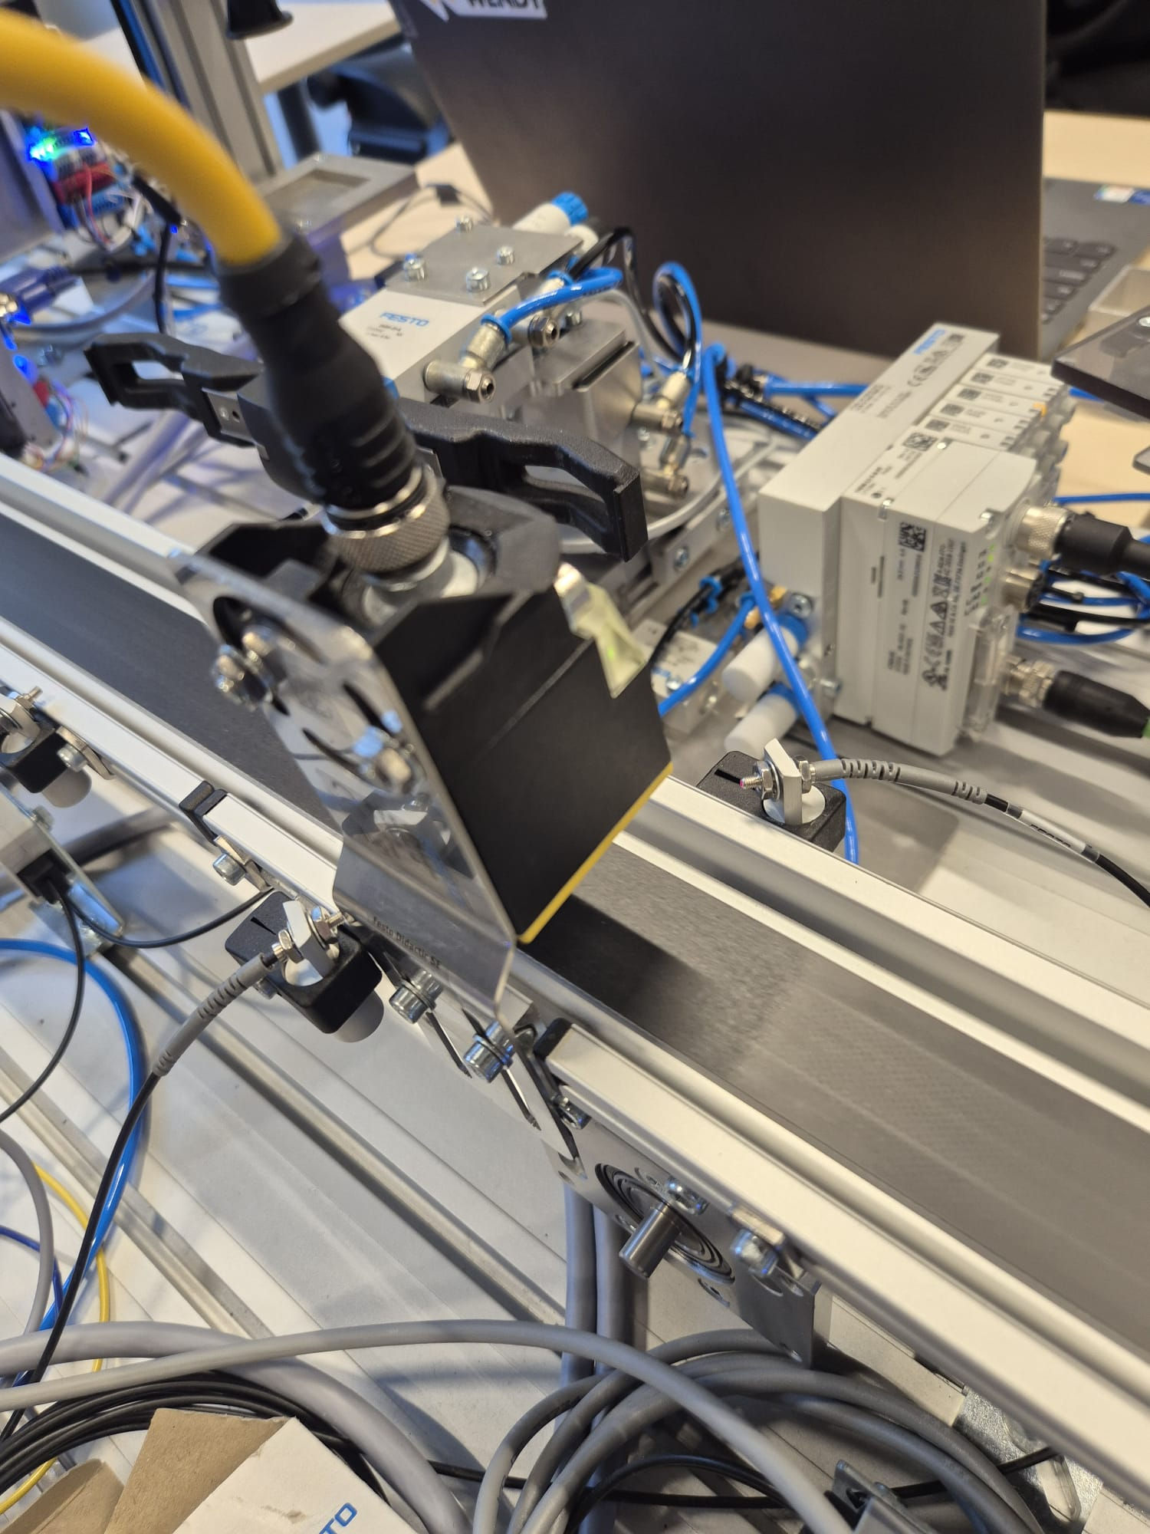
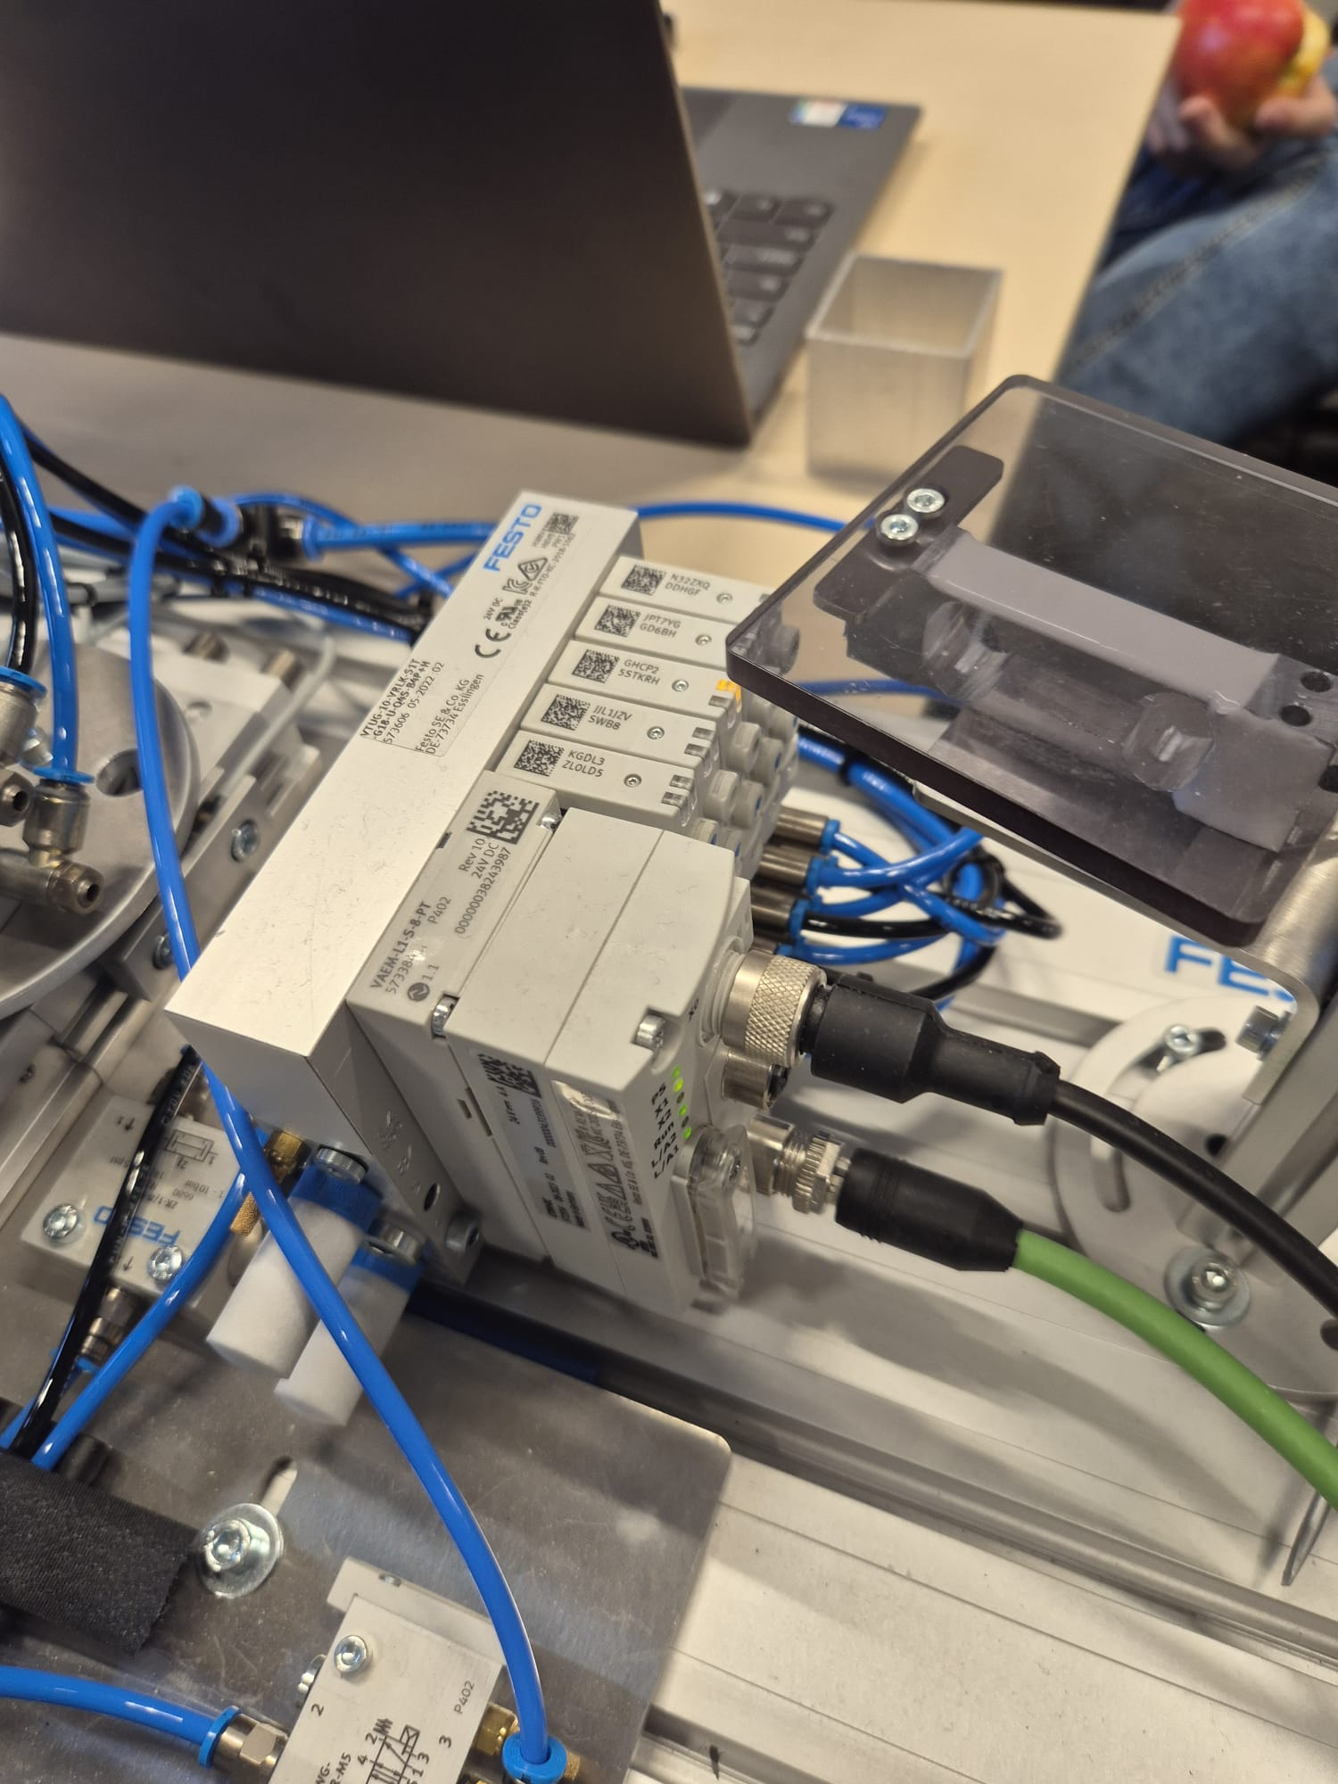
components
Powersupply makes 24v volt from 230v
Solenoid valve controls the movement of the pick and place arm
Turck writes data like weight and height from part to the chip
powersupply
RFID and IO module
RFID reader/writer turck
Solenoid valves

Slide 6
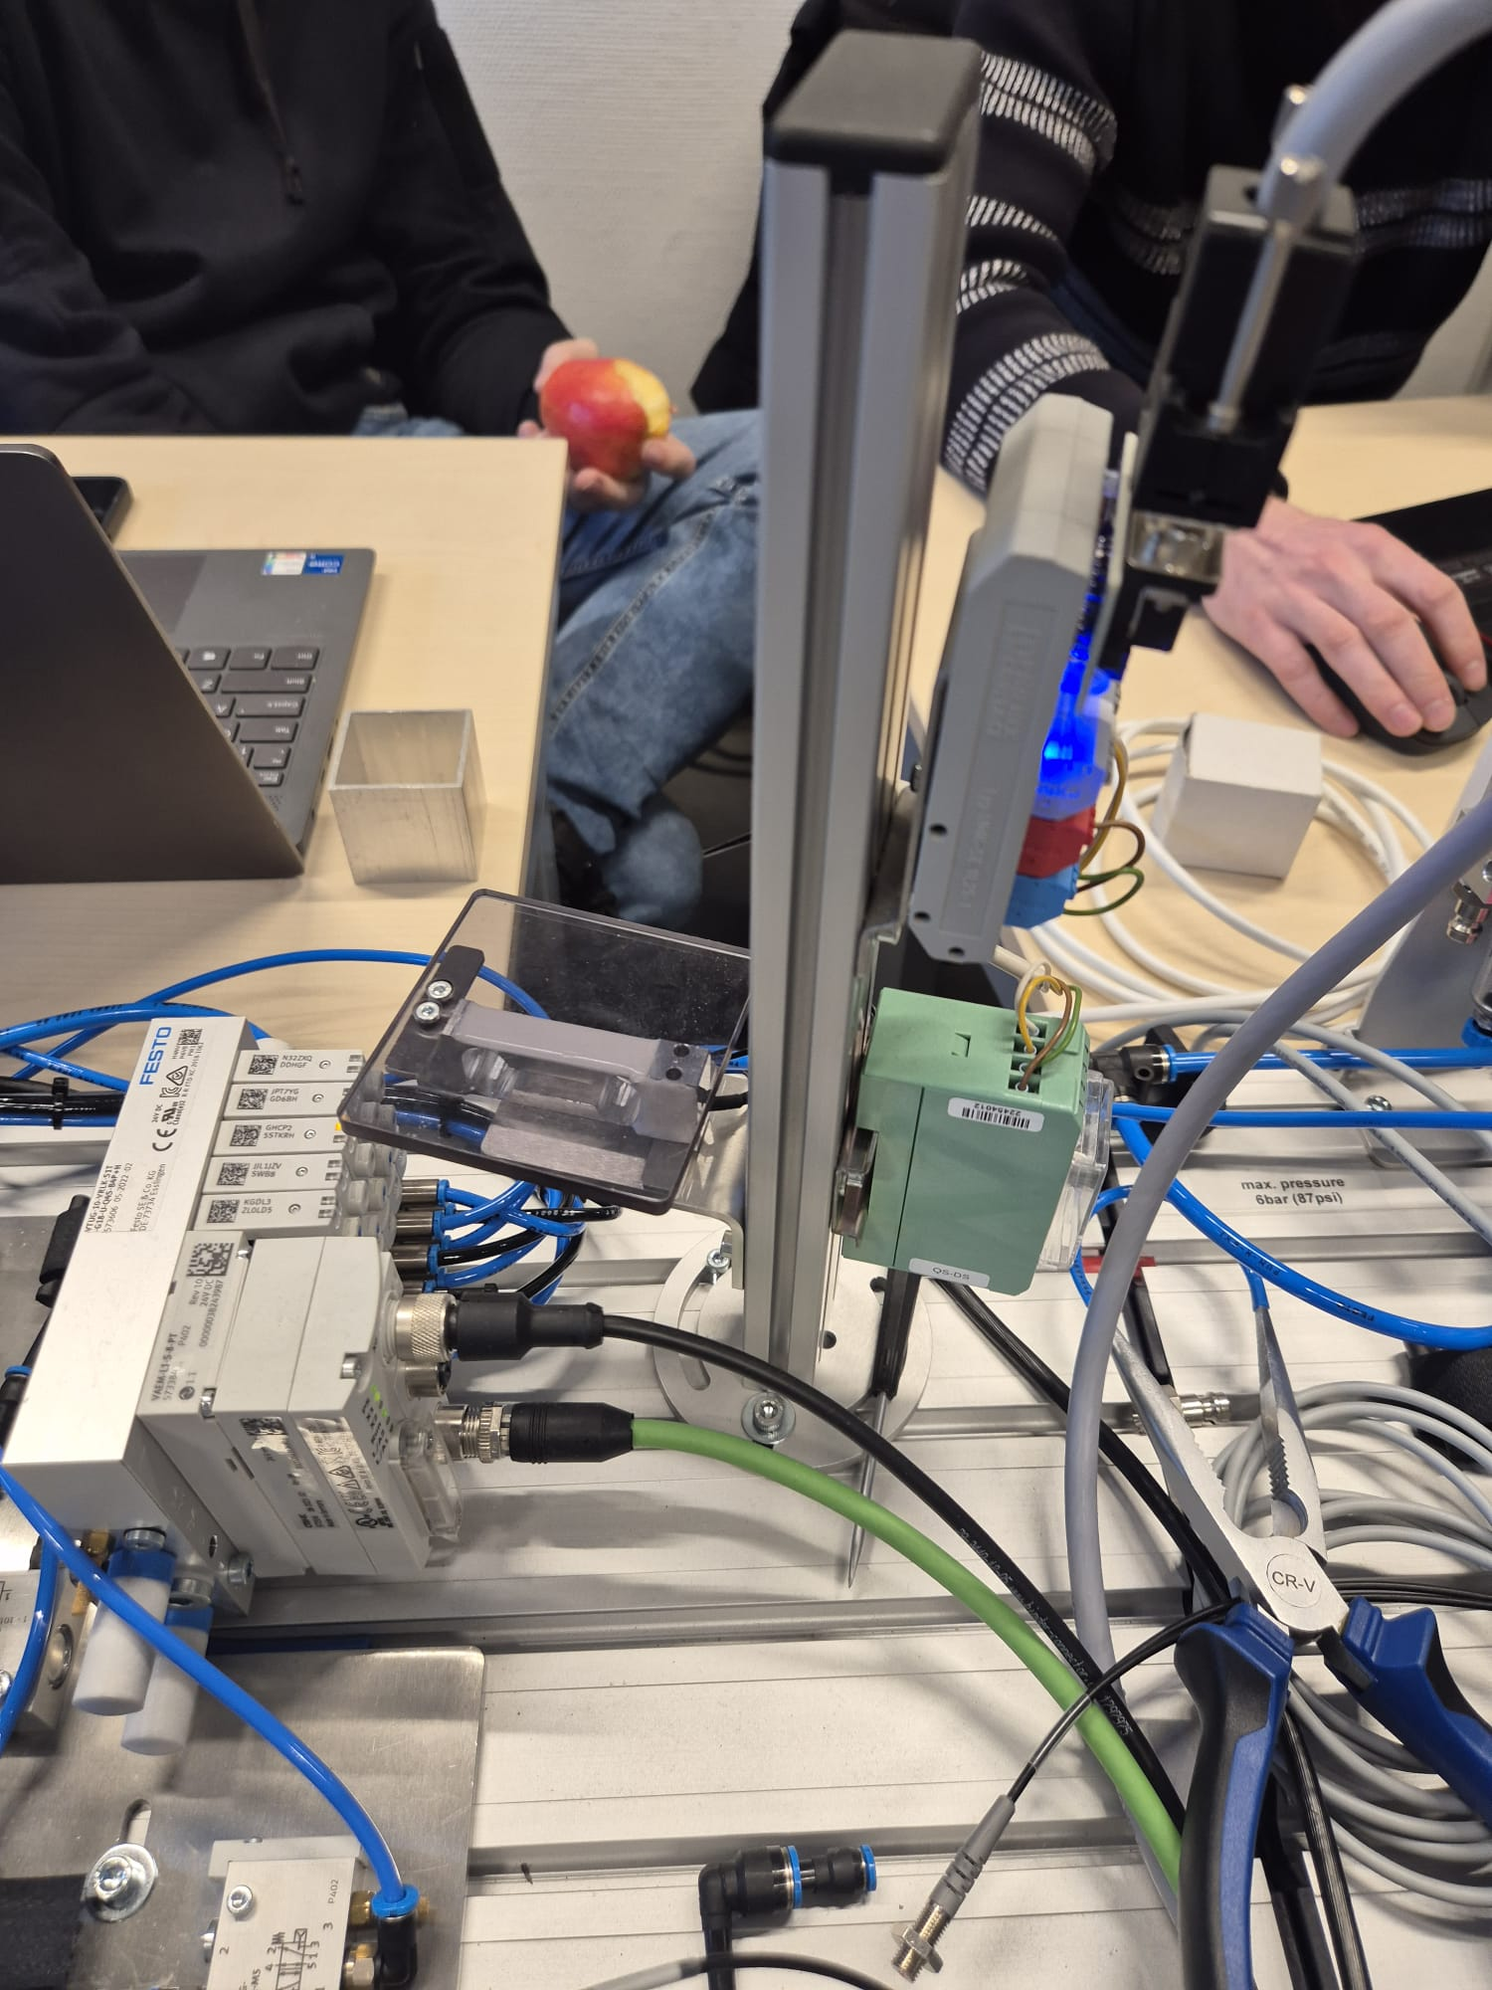
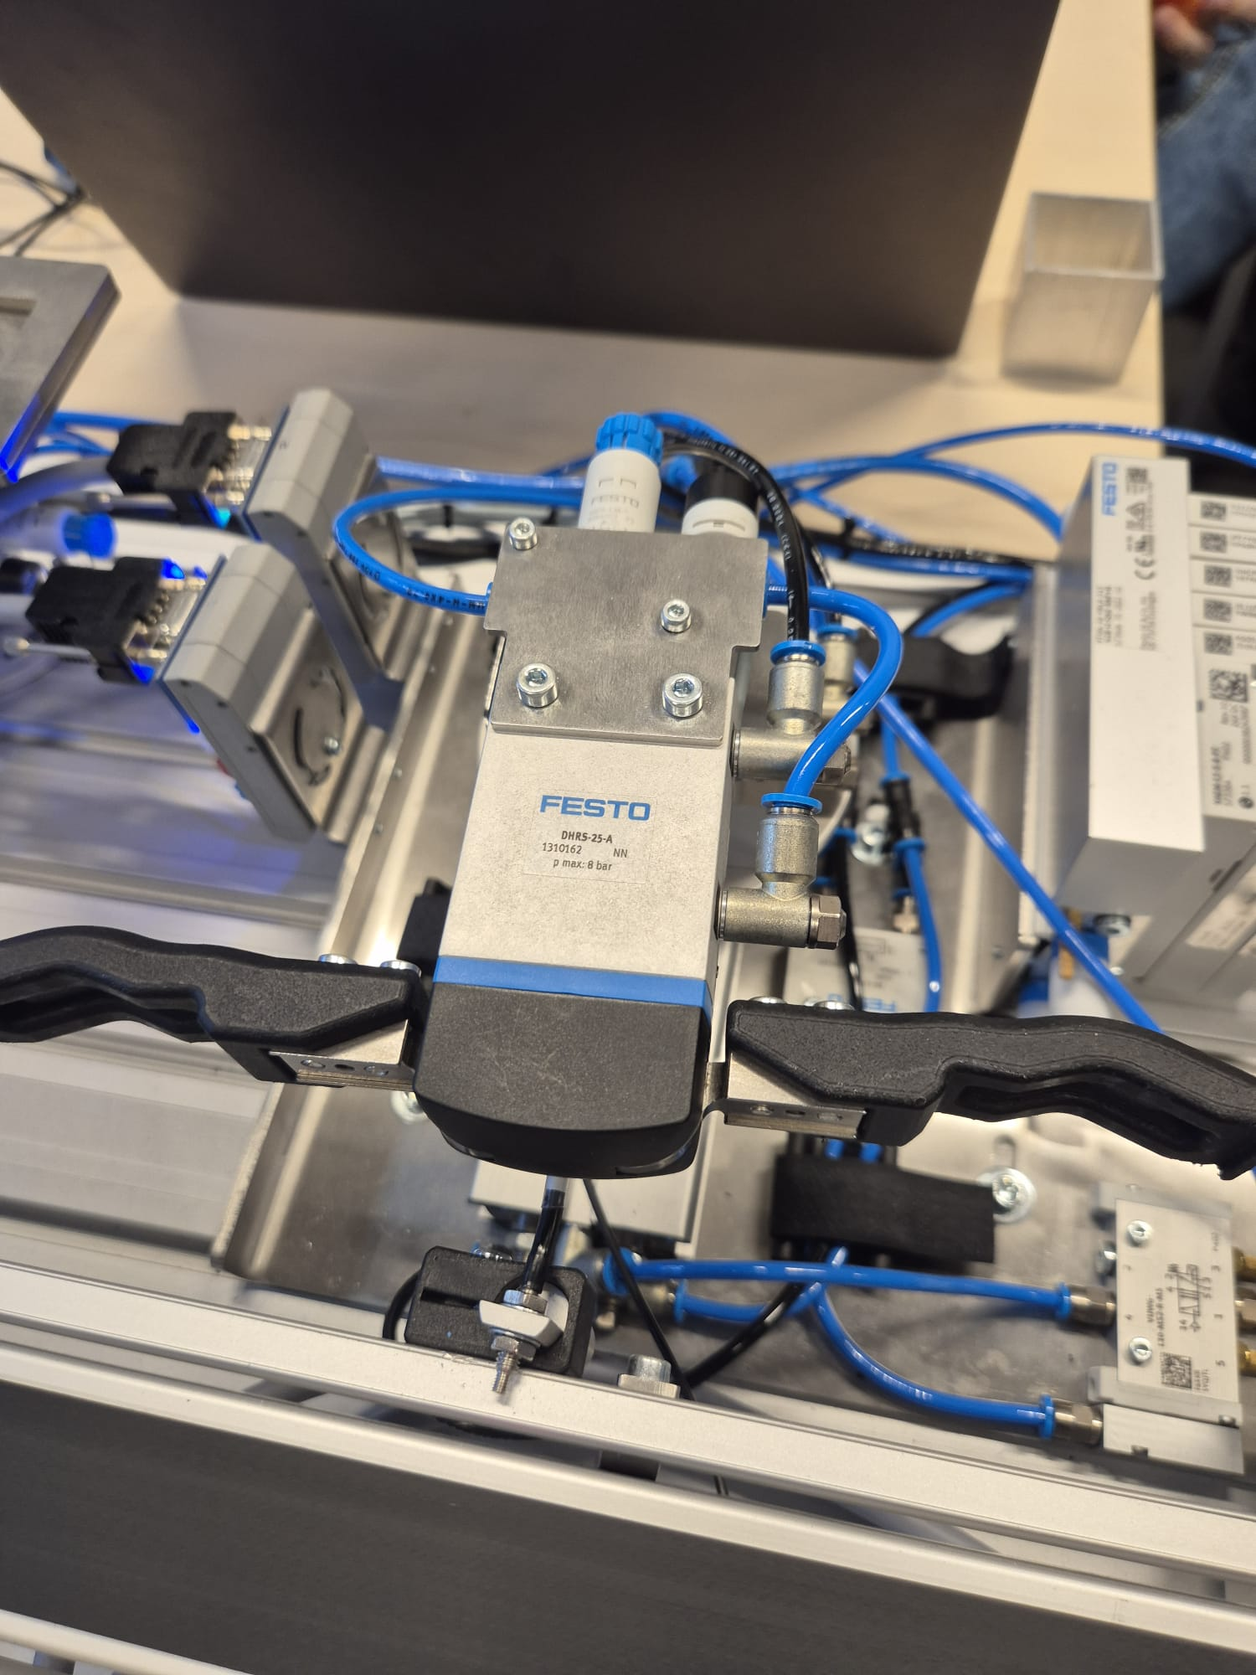
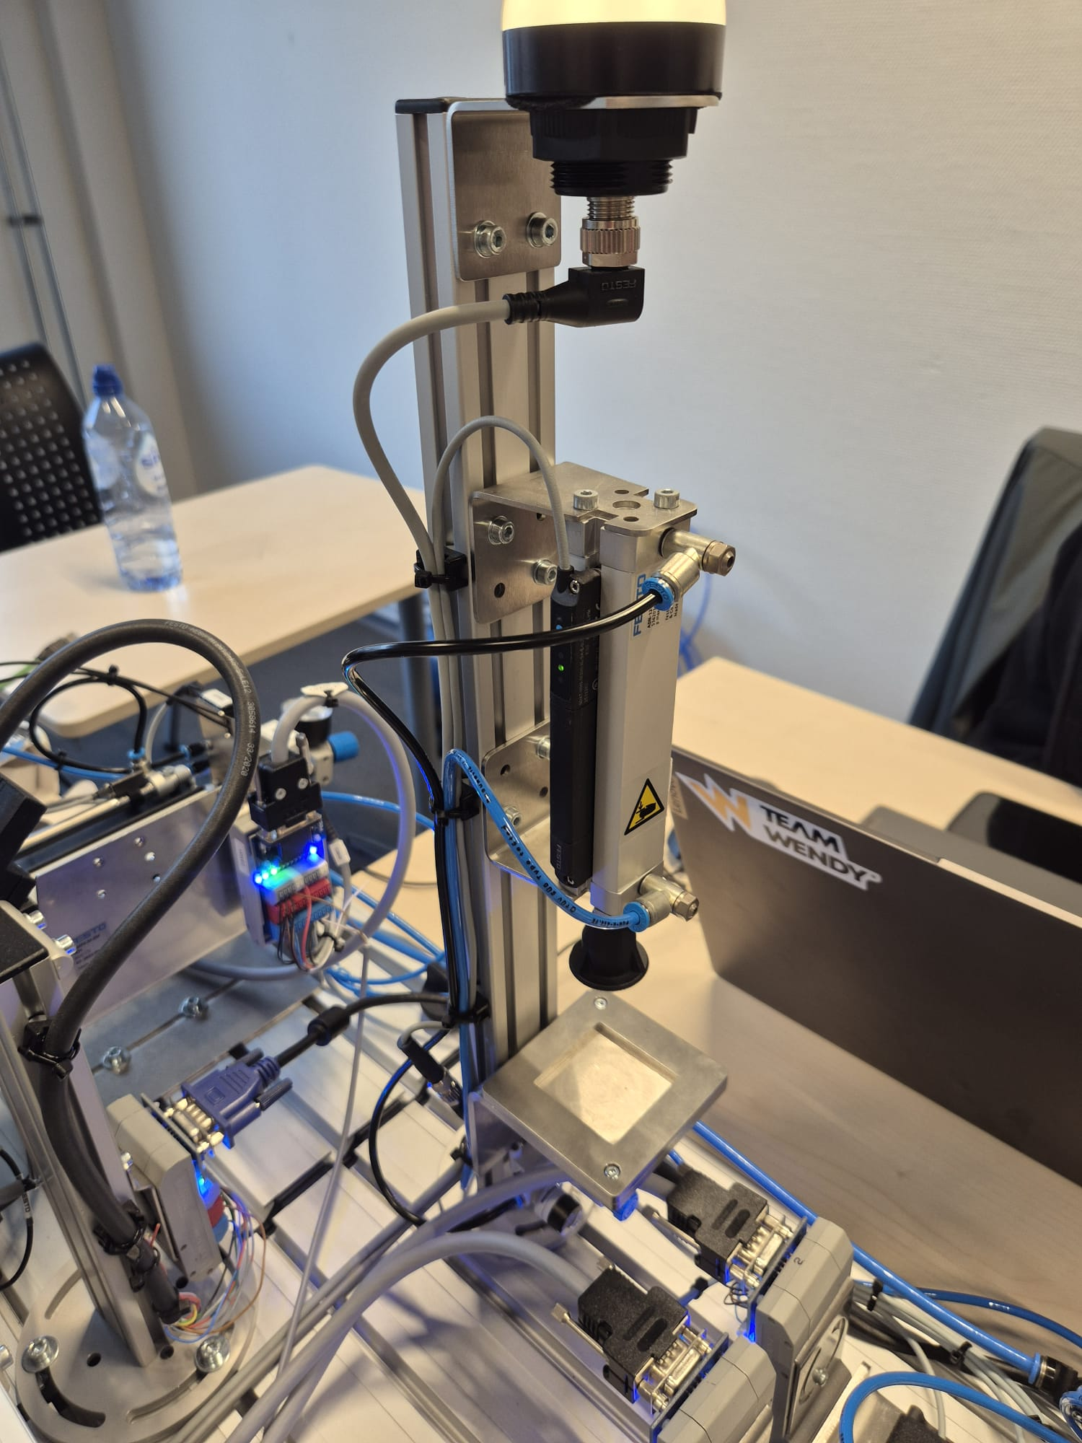
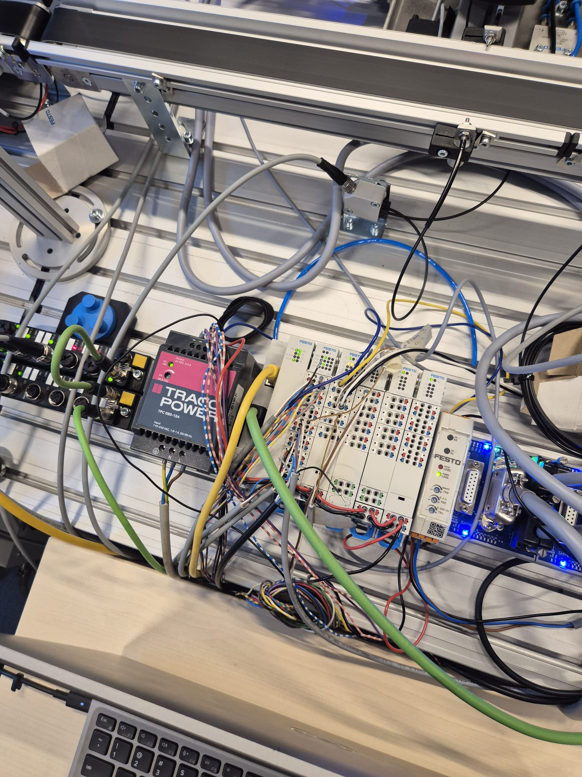
components
Weight measuring station weights part
Height measuring station measures the height of the part
Pick and place arm moves parts from the belt to the measuring and height station
Festo plc controls al the inputs and outputs
Weight measuring
Pick and place arm
Height measuring
Festo plc

Slide 7




ethercat
Ethercat is een real-time industriële Ethernet fieldbus die speciaal is ontwikkeld voor snelle en deterministische aansturing van I/O, sensoren en actuatoren.
Zeer hoge snelheid
Datalink layer
IP-adress hoeft niet te worden ingesteld
In the measuring station ethercat is used to control the solenoidsvalves for the movement of the pick and place arm and also controls the weight station. Al inputs from sensors are also with ethercat.

Slide 8

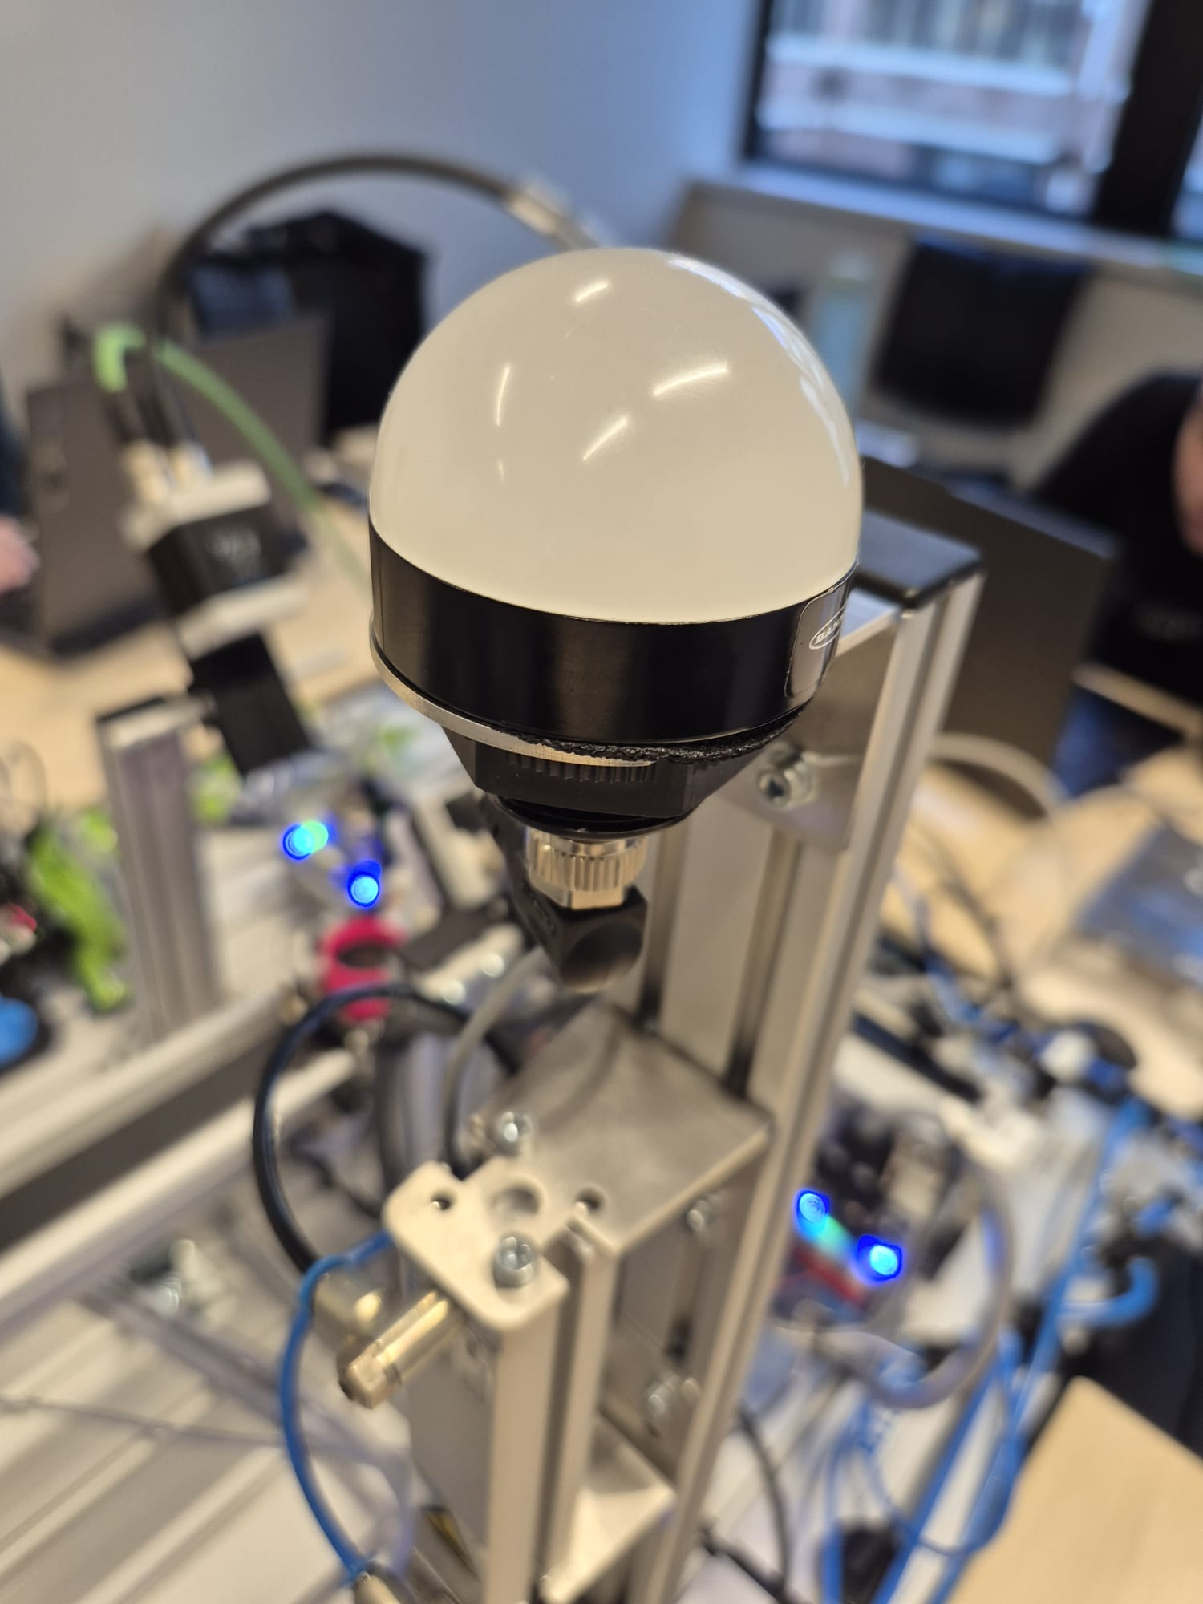


Modbus tcp
Modbus TCP is een industriële communicatievariant van Modbus die gebruikmaakt van TCP/IP-netwerken.
Modbus zit op de applicatie laag en tcp zit op de transportlaag
Niet geschikt voor tijdscritische dat- uitwisseling
IP-adress en channels moet worden ingesteld
In the measuring station modbus tcp is used for the light bulb, the height measuring and the RFID reader. These are less real-time critical

Slide 9


Opc ua
De communicatie tussen de PLC en Ignition SCADA verloopt via OPC UA.
OPC ua zit op de applicatie laag
Platform-onafhankelijk communicatie protocol
Wordt gebruikt om de waardes van de hoogte en gewicht van het blokje door te sturen van de PLC naar ignition.

Slide 10
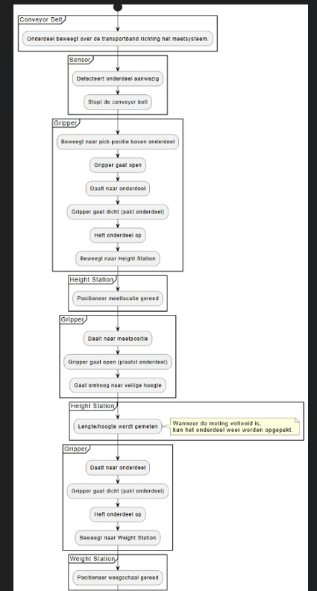
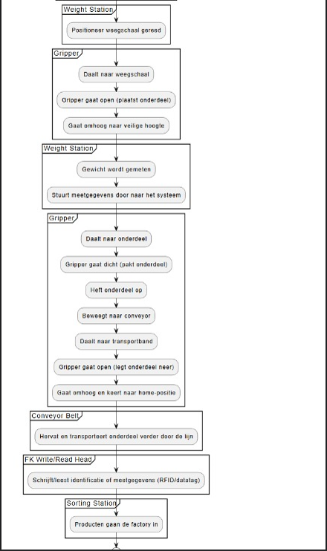
Programming
Flowchart of the program
Festo ethercat package
Festo io-link devices package
RFID universal data interface

Slide 11
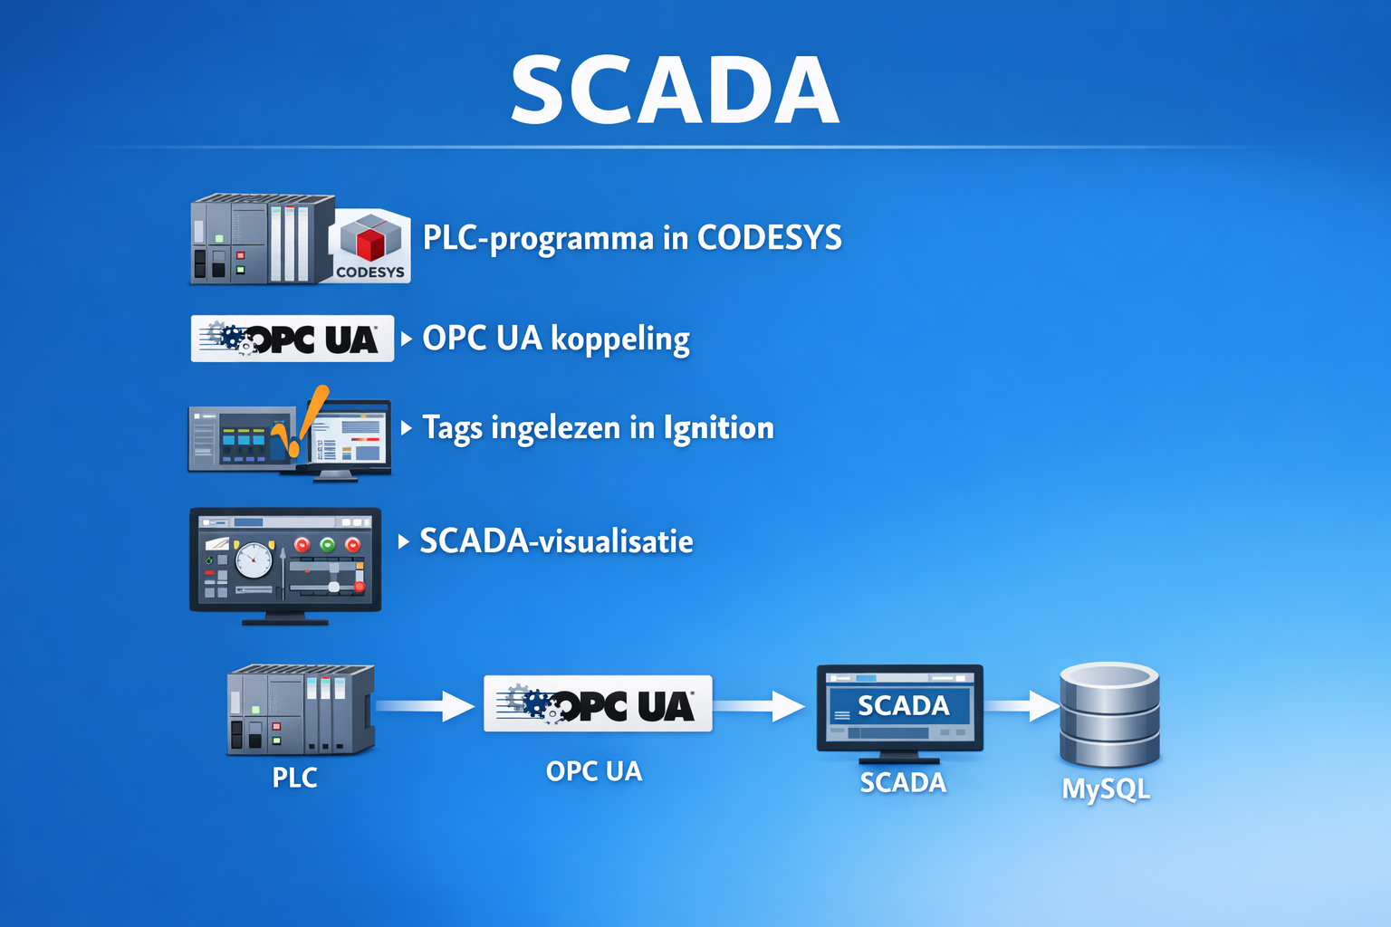
SCADA
PLC-programma codesys
OPC UA koppeling
Tags ingelezen in ignition
Scada visualisatie
Data opgeslagen in MySQL

Slide 12
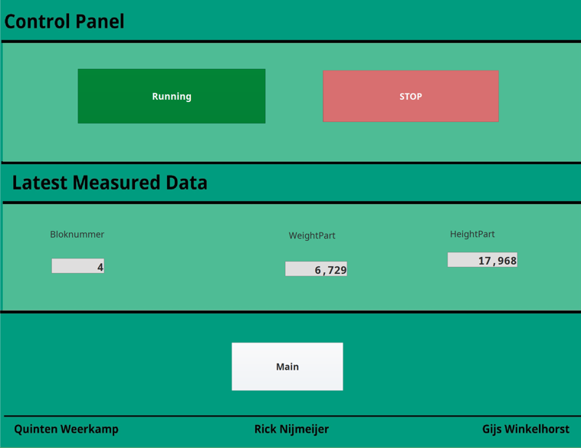
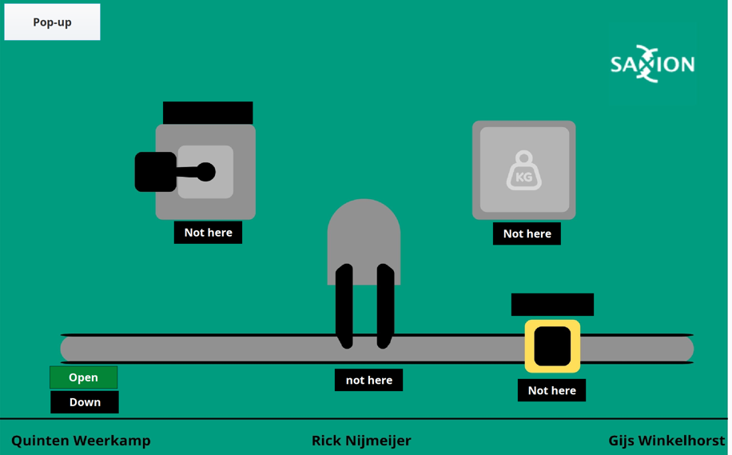
HMI
Operator can start and stop program
Last measured data is shown
Real-time position is shown

Slide 13
Encountered Problems
Making connection with the valve-island
Commisioning modbus devices
Bytes were not in right order for position sensor
Writing data to RFID-Tag
Making table for history

Slide 14
Conclusions and Recommendations
User can see weight, height and position of part in HMI
Part is weight
Height of the part is measured
Table of history still needs to be done

